Slide 1


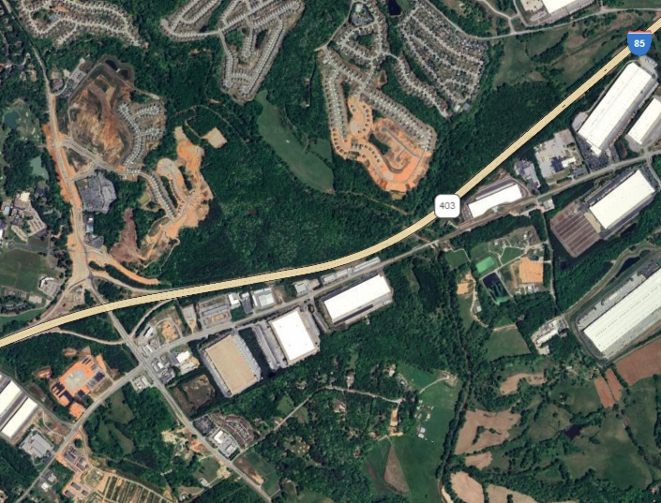
Rosetta Dillard – 404.680.1895 RDillard@AtlantaLandGroup.com
Trip Smith- 678.642.4640 TSmith@AtlantaLandGroup.com
KW Commercial Peachtree Road
804 Town Blvd. Ste A2040
Atlanta, GA 30319
404-419-3500
For Sale
19.1 +/- Acres Industrial Land
Interstate-85
at Mulberry River
Asking $650,000
Barrow County,
Georgia

Slide 2

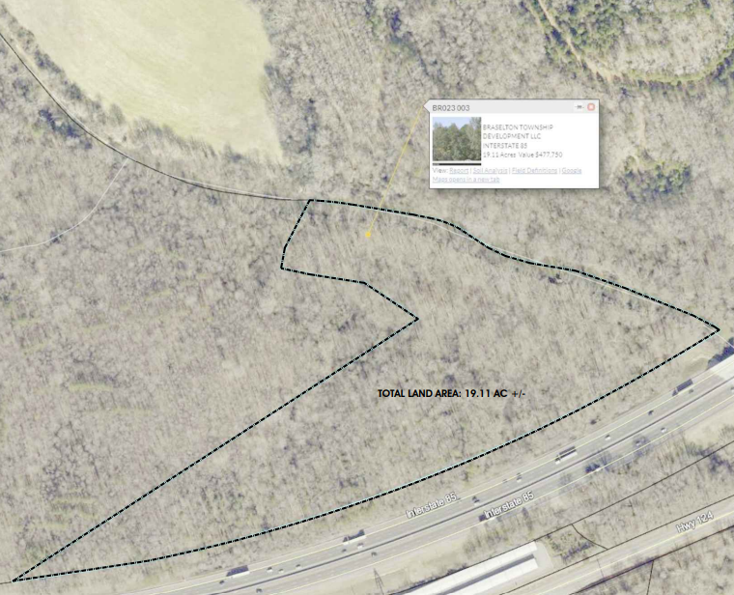
+/- 19.1 Acres
Zoned Industrial
All Utilities Available
Frontage on Interstate-5 at Mulberry River
Adjacent to New, Residential Developments & Other Industrial Sites
6-8 Usable Acres
On Western Side of Parcel
Includes Excellent I-85 Frontage

Slide 3
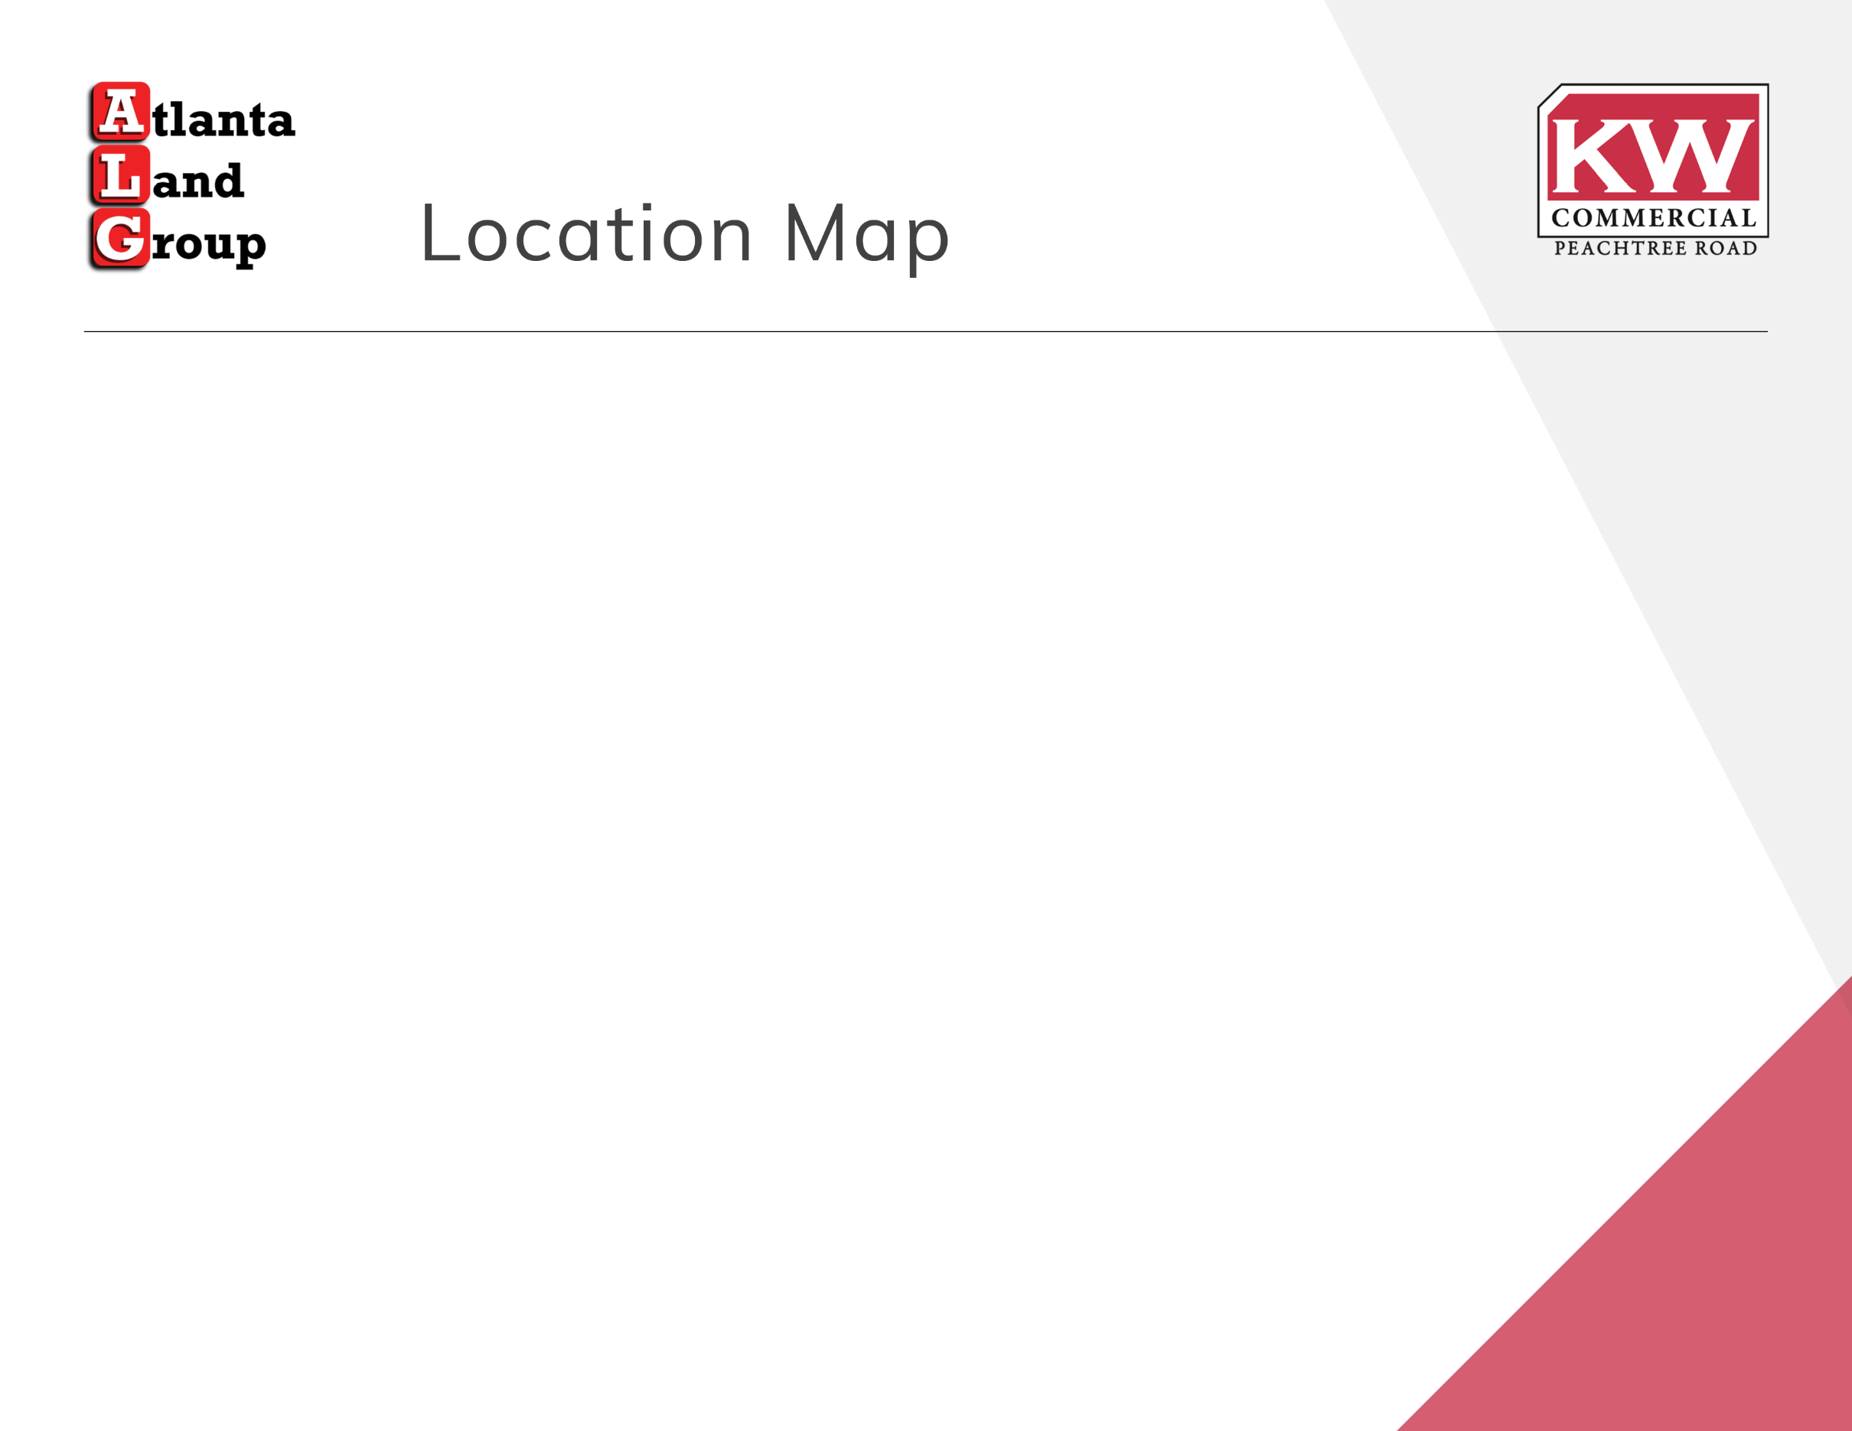
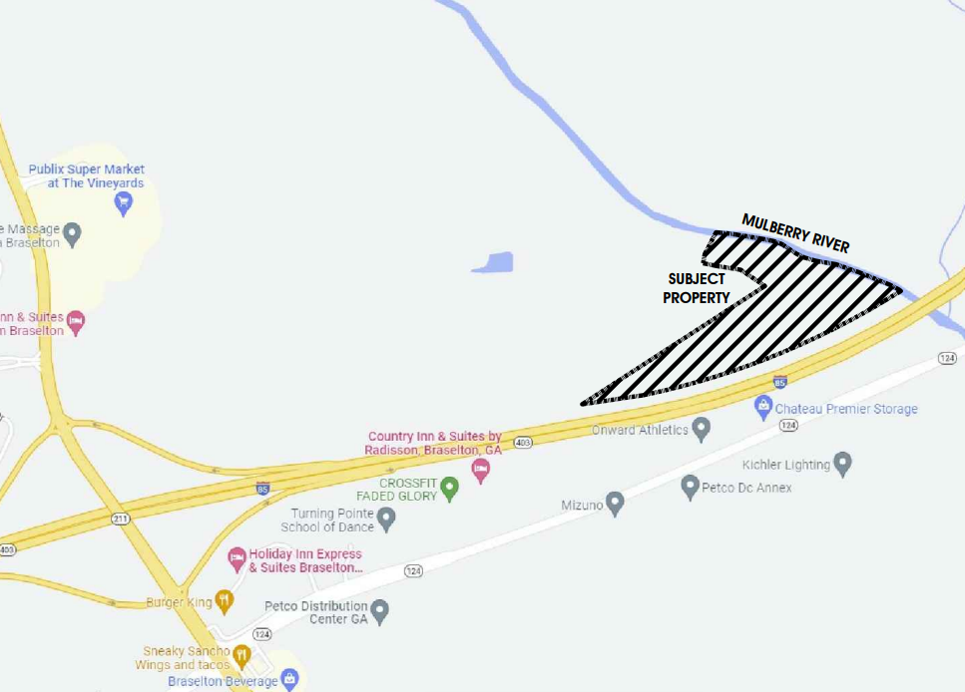

Slide 4



Rosetta Dillard
Associate Broker
Atlanta Land Group
RDillard@atlantalandgroup.com.com404.680.1895
Trip Smith
Associate Broker
Atlanta Land Group
TSmith@atlantalandgroup.com
678.642.4640

