Slide 1
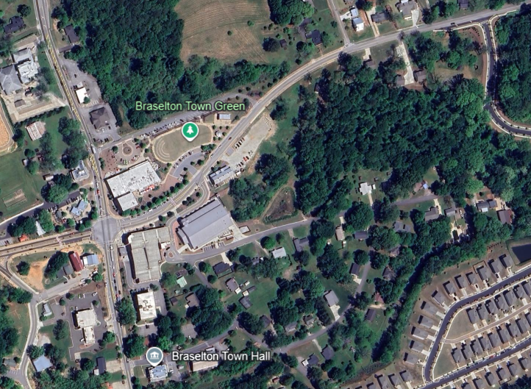
Rosetta Dillard – 404.680.1895 RDillard@AtlantaLandGroup.com
Trip Smith- 678.642.4640 TSmith@AtlantaLandGroup.com
KW Commercial Peachtree Road 804 Town Blvd. Ste A2040 Atlanta, GA 30319
404-419-3500
For Sale
2.47 +/- Acres
7.47 +/- Acres Mixed Use Land
Davis Street
Tract 2
Asking $500,000
Tract 3
Asking $820,000
Downtown Braselton, Georgia

Slide 2
+/- 2.47 Acres
+/- 7.47 Acres
Zoned Mixed Use
All Utilities Available
Fully Entitled, All Zoning Approved
Approved for Hotels, Townhomes
Hotel Entitled for 35 Rooms, 49 Parking Spaces
35 Townhomes Site Plan Approved & Entitled
Townhomes priced Competitively at $22,000/lot
Adjacent to Braselton Brewing Company
Walking Distance to Downtown, Live Music, Restaurants
Adjacent to D.R. Horton New Homes Development

Slide 3
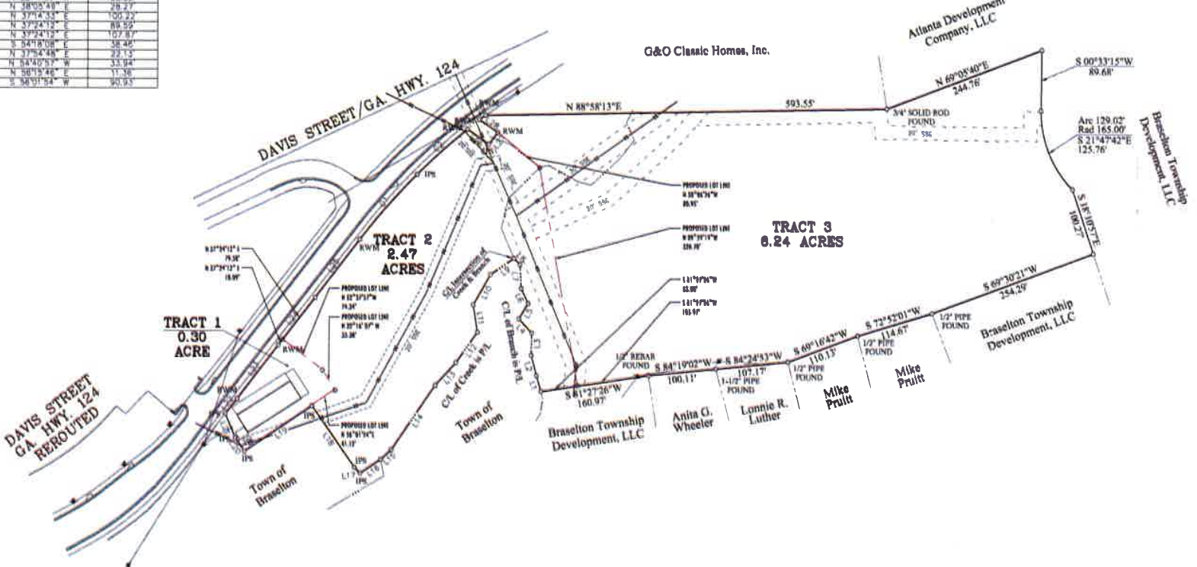
Parcel Map

Slide 4
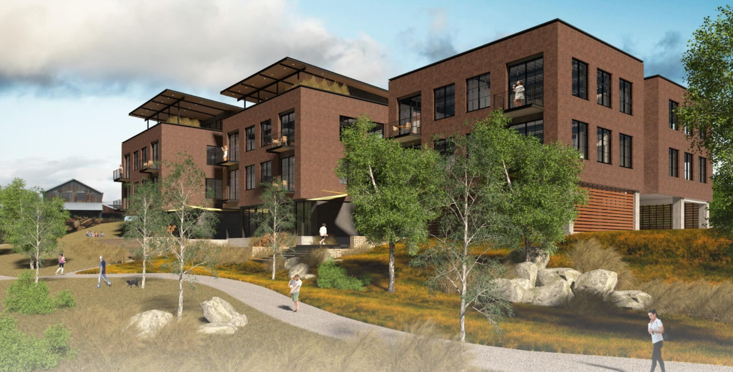
Approved for Boutique Hotel

Slide 5
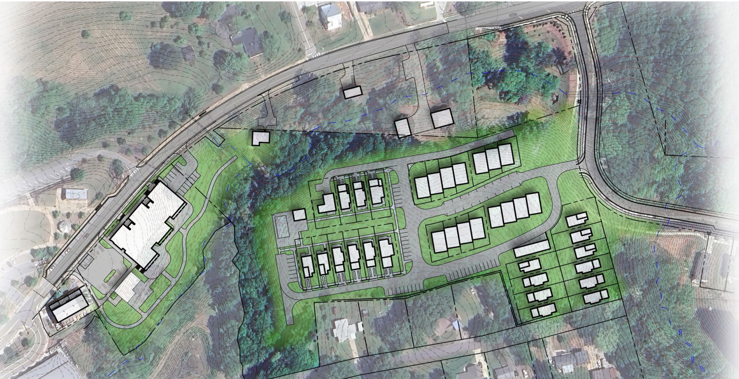
Approved for 35 Townhomes

Slide 6
Rosetta Dillard
Associate Broker
Atlanta Land Group
RDillard@atlantalandgroup.com.com404.680.1895
Trip Smith
Associate Broker
Atlanta Land Group
TSmith@atlantalandgroup.com
678.642.4640

