Slide 1
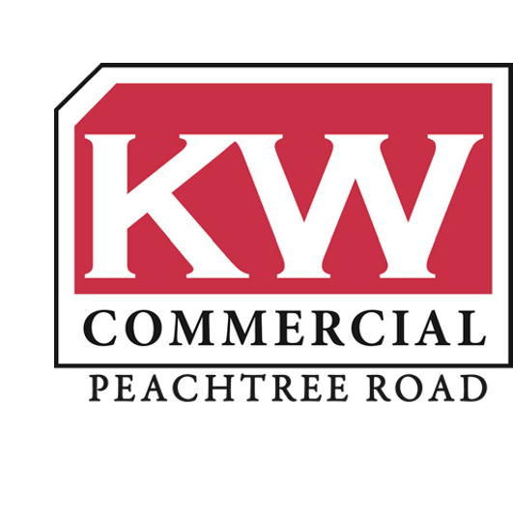
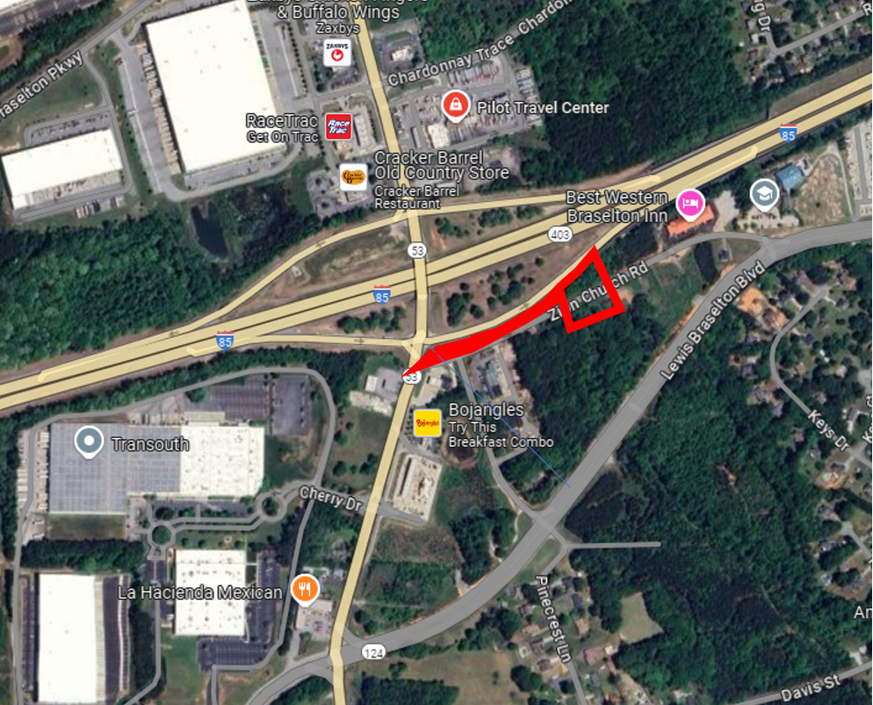
Rosetta Dillard – 404.680.1895 RDillard@AtlantaLandGroup.com
Trip Smith- 678.642.4640 TSmith@AtlantaLandGroup.com
KW Commercial Peachtree Road 804 Town Blvd. Ste A2040 Atlanta, GA 30319
404-419-3500
For Sale
1.01 +/- Acres
0.98 +/- Acres Commercial Land
Zion Church Road
Lewis Braselton Blvd
Asking $200,000
Asking $450,000
Braselton, GA

Slide 2
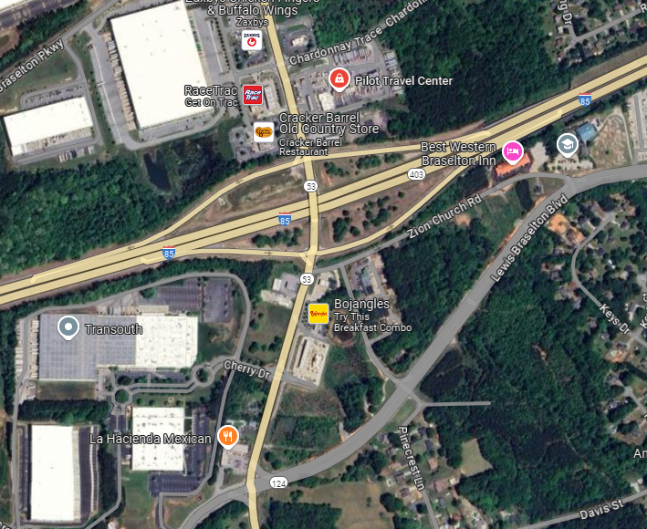
+/- 0.98 Acres
Zoned Commercial
All Utilities Available
Fully Entitled, All Zoning Approved
High Traffic Corner Tract at Zion Church Road and Lewis Braselton Boulevard
Flat, Level Topography
Income-Generating Property Currently On-Site
Excellent Opportunity to Assemble Land

Slide 3
+/- 1.01 Acres
Zoned Commercial
All Utilities Available
Fully Entitled, All Zoning Approved
Frontage on Zion Church Road
Nearby Other Small, Commercial Buildings
Flat, Level Topography
Excellent Opportunity to Assemble Land

Slide 4
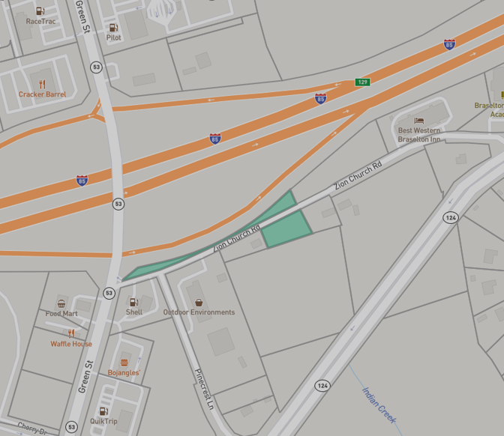
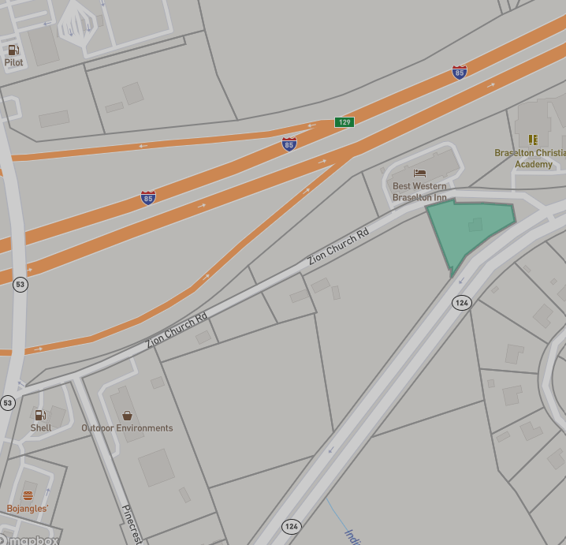
Parcel Map

Slide 5
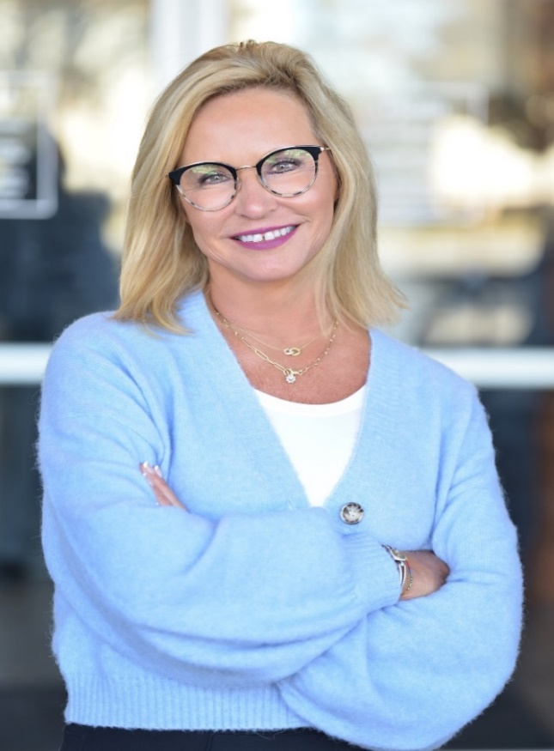
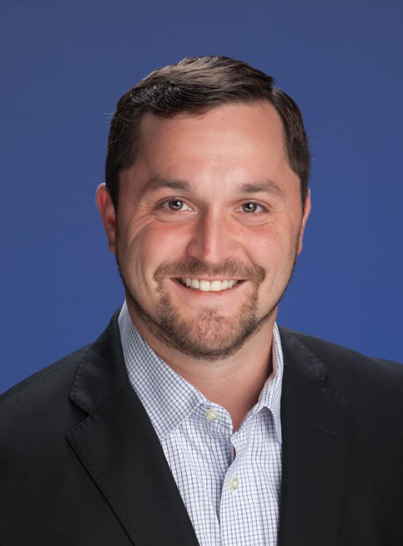
Rosetta Dillard
Associate Broker
Atlanta Land Group
RDillard@atlantalandgroup.com.com404.680.1895
Trip Smith
Associate Broker
Atlanta Land Group
TSmith@atlantalandgroup.com
678.642.4640

